Slide 1
Salesforce Programmatic Model - 4

Slide 2
Agenda
Model – View – Controller (MVC)​
What is a Visualforce Page?
Visualforce Overview & Architecture​
Visualforce Example
Visualforce Markup​
Visualforce Controllers – Standard, Custom and Extensions
Display Fields and Tables in Visualforce
Variables and Global Variables​
Where can Visualforce pages be used?

Slide 3
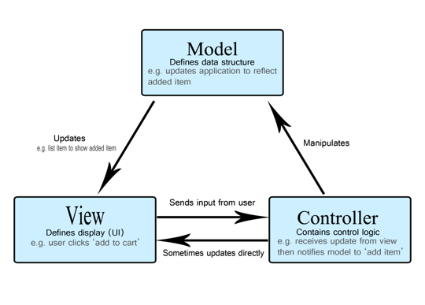
Model – View – Controller (MVC)

Slide 4
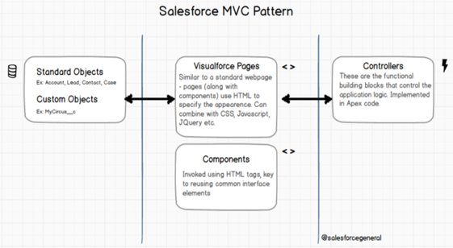
Model – View – Controller (MVC) Cont.

Slide 5
What is a Visualforce Page?
Visualforce is a salesforce markup language which allows user to create interface component in salesforce.
Developers can use Visualforce to create a Visualforce page definition. A page definition consists of two primary elements:
Visualforce markup
Visualforce controller
Design definition of the application's user interface.
Ability to reference CSS, AJAX, Flex and other web technologies.
Supports standard query strings for parameters, referenced by apex/page URL syntax.
Composed on the server, not the client.
Data is placed on the page using Expressions.
Expressions are filled-in on the server.

Slide 6
Visualforce Overview & Architecture
Visualforce is a framework that allows developers to build sophisticated, custom user interfaces that can be hosted natively on the Lightning platform
The Visualforce framework includes a tag-based markup language, similar to HTML, and a set of server-side “standard controllers” that make basic database operations, such as queries and saves, very simple to perform.
User interfaces can extend the standard Force.com look and feel or replace it with a unique style and set of interactions

Slide 7
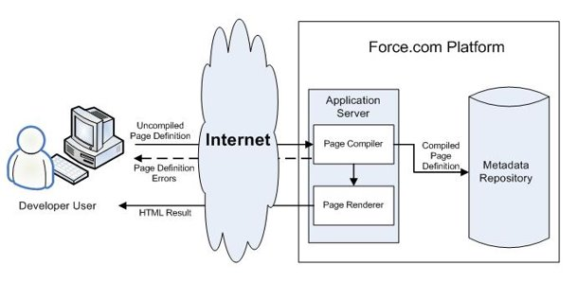
Visualforce Overview & Architecture Cont.
When a developer finishes writing a Visualforce page and saves it to the platform, the platform application server attempts to compile the markup into an abstract set of instructions that can be understood by the Visualforce renderer.
Visualforce System Architecture – Development Mode

Slide 8
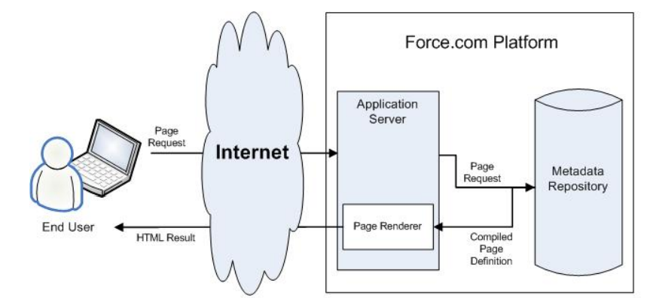
Visualforce Overview & Architecture Cont.
Visualforce System Architecture – Standard User Mode

Slide 9
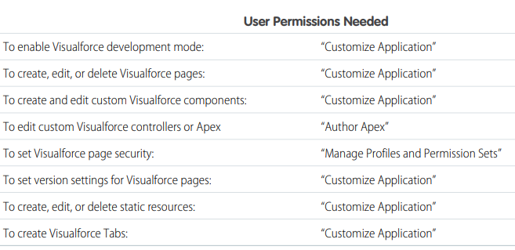
Permissions for VF Page Development

Slide 10
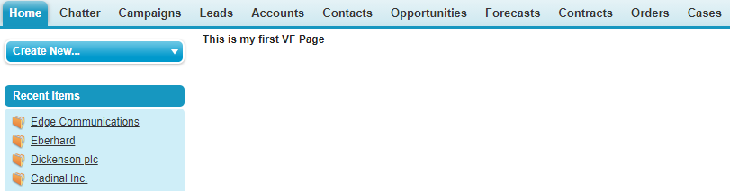
Visualforce Example
Let's create a simple visualforce page. Go to the developer console → File → New → Visualforce page. The new window opens asking for a page name. Let us now call it MyFirstVFPage.
Code:
<apex:page>
<h1>This is my first VF Page</h1> </apex:page>
Now, Click Save. Then, click on Preview button. This will open a new browser tab showing the result as shown in the following screenshot.

Slide 11
Visualforce Markup
Visualforce markup consists of Visualforce tags, HTML, JavaScript, jQuery, CSS or any other Web-enabled code embedded within a single <apex:page> tag.
Visualforce is salesforce custom markup language and represents the view in a Model-View-Controller software design pattern.
The markup defines the user interface components that should be included on the page, and the way they should appear.

Slide 12
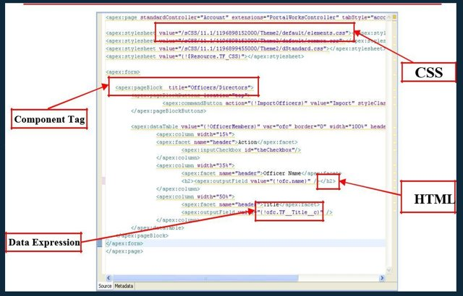
Visualforce Markup Cont.

Slide 13
Visualforce Controllers
A Visualforce controller is a set of instructions that specify what happens when a user interacts with the components specified in associated Visualforce markup, such as when a user clicks a button or link.
Controllers also provide access to the data that should be displayed in a page, and can modify component behavior.
Visualforce controllers are of three types they are
Standard controllers.
Custom Controllers.
Extension controllers.

Slide 14
Standard Controller
A standard controller exists for every Salesforce object that can be queried.
The standard controller is a pre-built visualforce controller by salesforce.com.
Standard controllers consists of same functionality and logic that are used for standard Salesforce pages. For example: Save, Edit, Delete
If you use the standard Accounts controller, clicking a Save button in Visualforce page results in the same functionality as clicking Save on a standard Account edit page.
Syntax:
<apex:page standardController="Account">
// Vf page code
</apex:page>

Slide 15
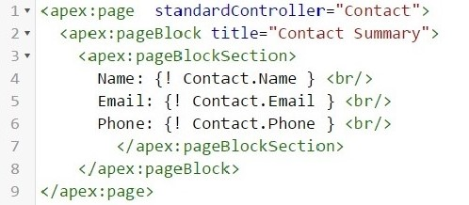
Standard Controller Cont.
Example:
Let us create a Visualforce page to get the information of a record in the Contact object.

Slide 16
Custom Controller
When a developer needs more customize functionality then the custom apex controller classes are used.
A custom controller is a class written in Apex that implements all of a page's logic, without leveraging a standard controller.
Only one custom controller can be used for one VF page.
Syntax:
<apex:page controller="MyCustomController">
// Vf page code
</apex:page>

Slide 17
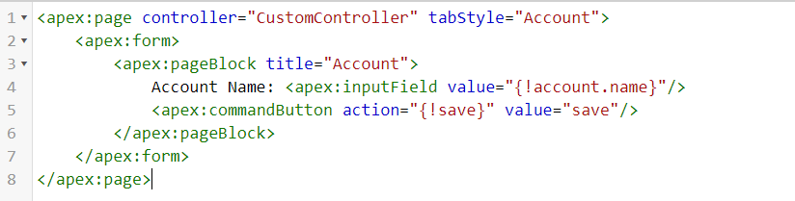
Custom Controller Cont.
Example:
Let us create a Visualforce page to fetch the Account record from apex class, display its name and update the name from VF page.

Slide 18
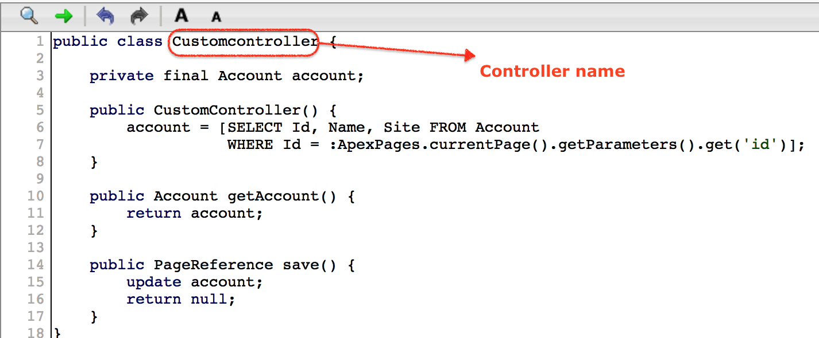
Custom Controller Cont.
Custom Controller Code:

Slide 19
Extension Controller
A controller extension is an Apex class that extends the functionality of a standard or custom controller.
Extension controllers give additional functionality to a standard controller and controller.
When we need both standard controller and Controller functionality we use extension controllers to call Controller in visual force page.
More than one extension can be used on one page. If there is more than one extension it will execute from left to right.
Syntax:
<apex:page standardcontroller= “Account” extensions=“CustomExtension1, CustomExtension2”>
// Vf page code
</apex:page>

Slide 20
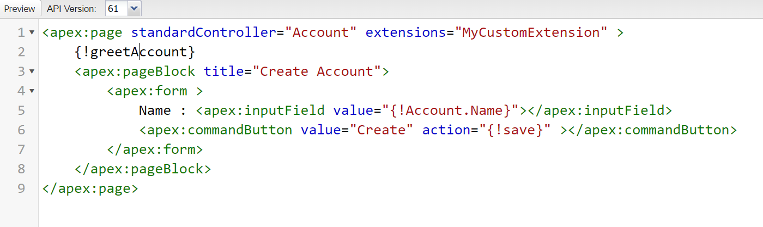
Extension Controller Cont.
Example:
Let us create a Visualforce page to get a message as: Hello AccountName using extension and which also uses the standard save action of standard controller Account.

Slide 21
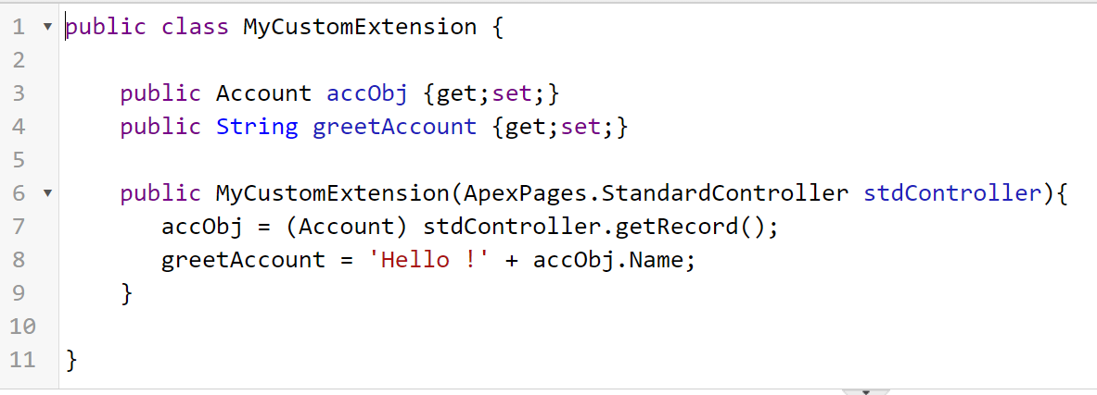
Extension Controller Cont.
Extension Code:

Slide 22
Extension VS Controller
Extension | Controller
A controller extension is any Apex class containing a constructor that takes a single argument of type ApexPages. It provides additional functionality to a controller – either a standard controller or a custom controller. | It is an Apex class that implements all of the logic for a page without leveraging a standard controller.
You can use multiple Apex classes separated by comma. | You can use only one Apex class.
Use controller extensions when Leverage the built-in functionality of a standard controller but override one or more actions, such as edit, view, save, or delete. Add new actions. Build a Visualforce page that respects user permissions. Although a controller extension class executes in system mode, if a controller extension extends a standard controller, the logic from the standard controller does not execute in system mode. | Use custom controllers when you want your Visualforce page to run entirely in system mode, which does not enforce the permissions and field-level security of the current user.

Slide 23
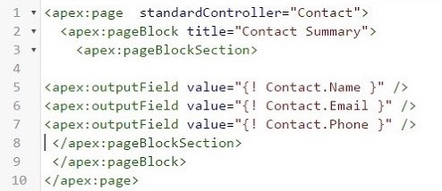
Display Fields
When we want to display the fields of a record in a formatted manner with column headers, rather than just the labels and values, we can use the OutputField option. The code given below shows the apex program to display the filled data from Contact. As you can see, we do not need the labels to be in place to indicate the field values.

Slide 24
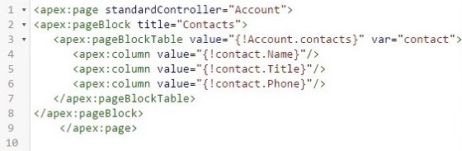
Display Tables
We can display all the records of a details table by taking a value from a master table. For example, we can display all the contacts associated with an account. In such case, we use the iteration component which in our case is the contacts table linked to account. Below is the code to display all the contacts associated with the Account table.

Slide 25
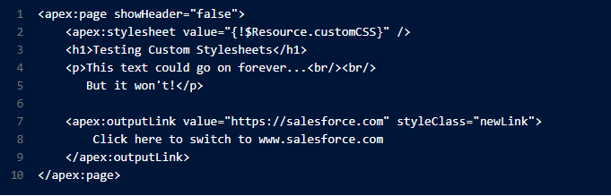
Include CSS in VF
Use the <apex:stylesheet> tag or static HTML to include your own style sheet or styles.

Slide 26

Include CSS in VF
you can define inline CSS code, just like in a regular HTML page.

Slide 27
Include JS in VF
including JavaScript in a Visualforce page is placing the JavaScript in a static resource, then calling it from there. For example,

Slide 28
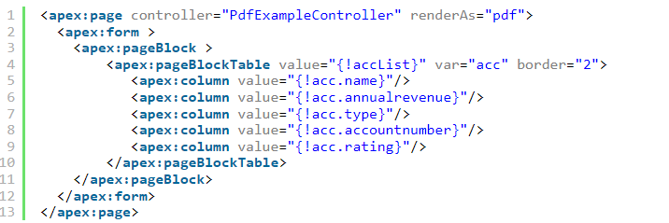
Generate PDF

Slide 29
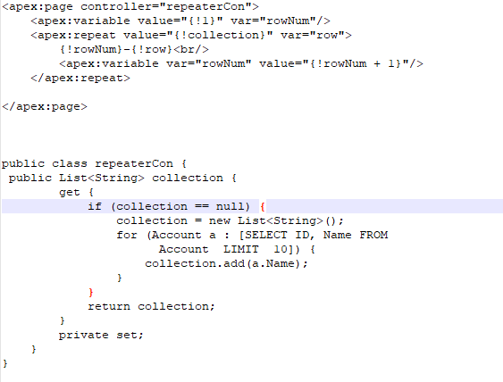
apex:variable & apex:repeat
An iteration component that allows you to output the contents of a collection according to a structure that you specify. The collection can include up to 1,000 items.

Slide 30
Variables and Global Variables
From the Custom Controller and extensions, you can refer the Apex variables(class variables) using the expressions. For example:
For custom: {!firstName} or For Standard: {!Account.Phone}
Global variables contains the reference of general information about the current user and your organization on a page.
Global variables must be referenced using Visualforce expression syntax to be evaluated, for example,
{!$User.FirstName}
{!$Label.customCurrency_label}
{!$CurrentPage.parameters.id}

Slide 31
Global Variables Cont.
Some Commonly used Global Variables:
$Label A global merge field type to use when referencing a custom label. {!$Label.firstrun_helptext}
$ObjectType A global merge field type to use when referencing standard or custom objects (such as Accounts, Cases, or Opportunities) and the values of their fields. {!$ObjectType.Account.Fields.Name.Label}
$FieldSet Provides access to a field set defined in your organization. {!$ObjectType.Account.FieldSets.myFieldSetName}
$Profile A global merge field type to use when referencing information about the current user’s profile. Use profile merge fields to reference information about the user’s profile such as license type or name. {!$Profile.Name}
$User A global merge field type to use when referencing information about the current user. {!$User.FirstName}

Slide 32
Where can Visualforce Pages be used?
Developers can use Visualforce pages to :
Override standard functionality, such as the New, Edit.
Override tab overview pages, such as the Accounts tab home page.
Define custom tabs.
Can be integrated with HTML, CSS, Ajax, jQuery.
Embed components in detail page layouts.
Create dashboard components or custom help pages.
Customize, extend, or integrate the sidebars in the Salesforce console
Add navigation menu items and actions in the Salesforce mobile app

Slide 33
References
Visualforce Developer Guide
https://developer.salesforce.com/docs/atlas.en-us.pages.meta/pages/pages_intro.htm
Trailhead
https://trailhead.salesforce.com/en/content/learn/modules/visualforce_fundamentals
Lightning Vs Visualforce
https://www.grazitti.com/blog/visualforce-vs-lightning-which-one-should-you-go-for/
Use Visualforce in Lightning Experience
https://trailhead.salesforce.com/en/content/learn/modules/lex_dev_visualforce/lex_dev_visualforce_intro

Slide 34
THANK YOU
Any questions?

